Slide 1
Moving On
Dealing with the emotional aspects of leaving academia
Presented at
The 6th Annual Online Career Conference for PhDs
Beyond the Professoriate
May 4, 2019

Slide 2
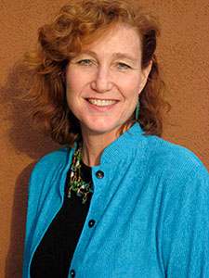
About me
Notes:
About me
I am now an academic career coach. I have had a highly varied career trajectory, changing actual careers 7 times, including legal assistant and university administrator.. This is not uncommon in today’s world.
I enjoy reading, writing, yoga, hiking and birdwatching.
I hold two master's degrees: an MA in social anthropology, an MEd in higher education administration, both from The University of Texas at Austin.
I raised two daughters on my own while I was a widow, and now live in Mount Pleasant, SC with my second husband and one very large grumpy cat named Tsar.
I don’t have a teleprompter, so you will see me looking down at my notes. I’ll try to look up at you, too, but I don’t want to miss some information I think could be helpful for you.

Slide 3

Notes:
Lead in
People after me will be discussing networking, changing your CV to a resume, and other pragmatic aspects of transitioning out of academia. This short presentation will lay out the emotional aspects you need to consider, and possibly actually experience, in order to build a new future for yourself.
I’ll begin by giving you a short description of where you might physically experience different emotions in your body, take a look William Bridges’ change theory, then tackle the negative emotions you will likely experience, as well as giving you some ideas on how to shift yourself into the more positive emotions associated with “moving on.” A bit of neuroscience will also be woven in.
I will give you some questions and have provided 5 (five) worksheets, which you can download, to help think about in this more deeply.

Slide 4

Notes:
Disconnect
For the vast majority of people pursuing PhDs and a life in academia, there is a disconnect between the number of people searching for work and the number of jobs available. The overproduction of PhDs has even been likened to a pyramid scheme.
You may have heard friends and family say something like, “You studied for how many years? And you can’t get a job?” For people outside of academia, the reality inside is often incomprehensible. Academia has a proscribed and rigid promotion path, from study to employment to tenure within the academy. It’s designed on a medieval German model of apprenticeship. And that’s not the way the rest of the world outside of academia operates. Careers and directions are much more fluid.
The most generous estimates of the number of people who hold academic, tenure-track jobs in any given year is 30%; based on my own research, looking at all fields combined for both STEM and Humanities, I believe the actual number is somewhere between 18-20%. That means at least 70% of academics are working part-time, most in adjunct positions that pay little and exact a lot. You may remember the story that went viral in 2013 on the death of Margaret Mary Vojtko (pronounced Voight-doh), an adjunct professor of French at Duquesne (pronounce Du-kane) University, living without health insurance, retirement benefits, on the edge of homelessness.
If you finished a PhD, congratulations! Only 50% of all people who start a PhD program finish one, leaving before graduation for various reasons. This number is one of the few statistics that has remained the same from the early 1960s.
(Anne Helen Petersen, the former academic turned BuzzFeed journalist, writes that universities similarly overproduce Ph.D.s, who are then often left jobless; https://www.chronicle.com/article/This-Academic-Took-a-Job-at/243264)
(As Herb Childress notes in an essay, his career issues were “not a problem of drive or focus; the horizon was illusory by design, moving according to someone else’s whims, continually drifting out of reach” (Chronicle of Higher Education review of on April, 9, 2019 The Adjunct Underclass, 2019.)
(I just saw an article in The Guardian from April 10, 2019, that only 3.5% of science PhDs secure permanent academic positions. That accords much more closely with numbers I have seen in discussions about this issue.)
(Leaving the Ivory Tower Paperback – March 27, 2001 by Barbara E. Lovitts)
(The University Is a Ticking Time Bomb Treating nearly 75 percent of the professoriate as disposable is not sustainable By Aaron Hanlon APRIL 16, 2019 https://www.chronicle.com/article/The-University-Is-a-Ticking/246119)

Slide 5
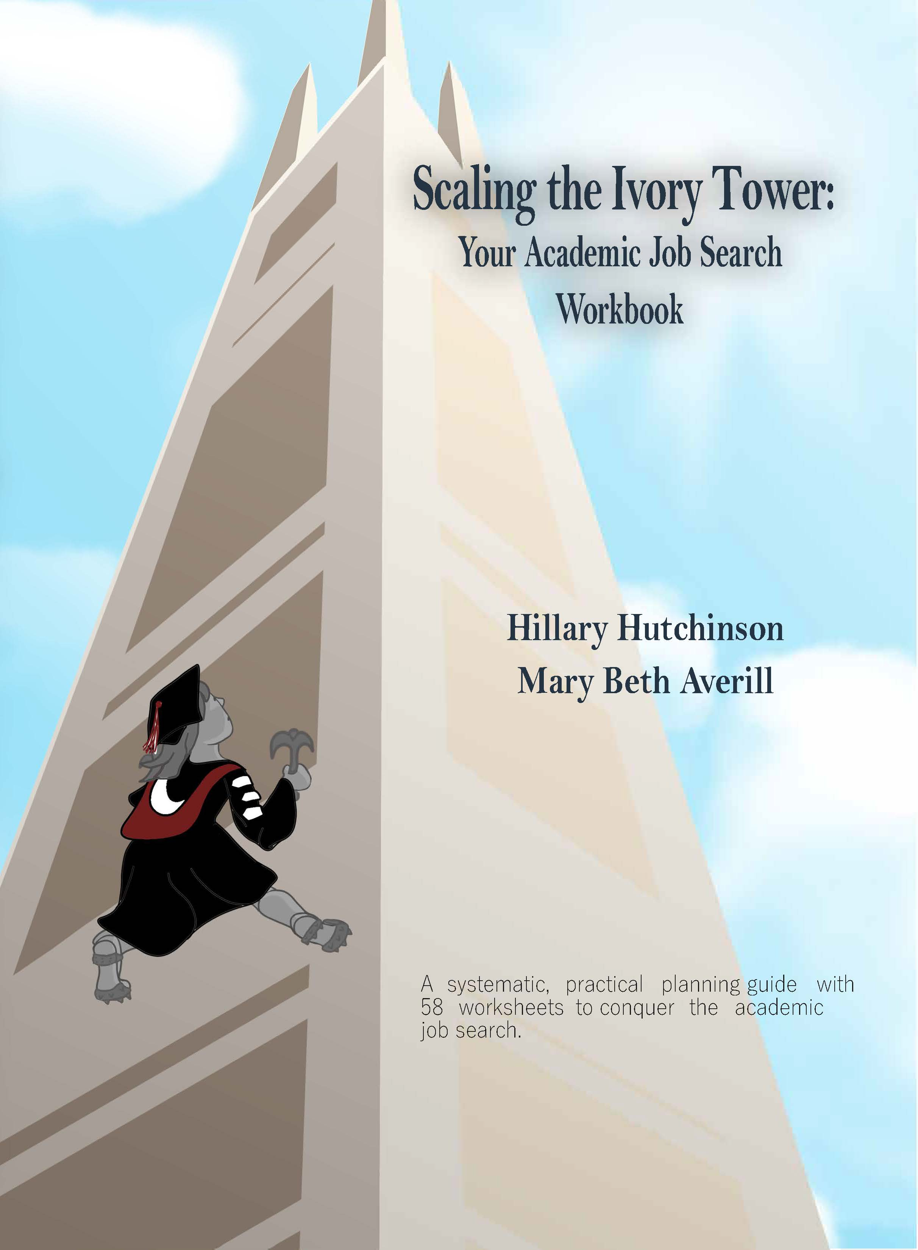
For more statistics:
Notes:
If you would like to know a whole lot more about the statistics for job hunting in academia feel free to check out our recent publication, Scaling the Ivory Tower: Your Academic Job Search Workbook. There are sections on the failure to track PhD job outcomes, the number of job applicants, and the chances of getting a tenure track job.
https://smile.amazon.com/gp/product/179460930X/ref=dbs_a_def_rwt_bibl_vppi_i1#customerReviews

Slide 6
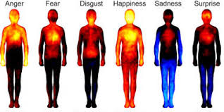
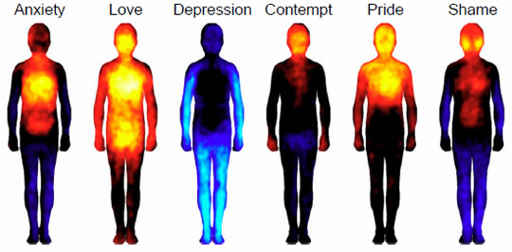
Notes:
Processing emotions
As you begin to process all kinds of emotions on the decision to leave, pay attention to the way in which your body is reacting. You get a lot more information from your body than you may realize—Ann Betz, who has worked for over 20 years on issues of mind and body integration, says you get nine times more information from your body than your brain. Emotions have been around for millenia and serve a very real purpose: they prepare us to react swiftly to both danger and opportunity. It’s worth paying attention to what your emotions are trying to tell you.
These pictures come from research done by Lauri Num-men-maa and colleagues that asked 701 participants in both Western European and East Asian countries to draw where they felt emotion in their bodies. Yellow indicates the highest level of activity, followed by red. Black is neutral, while blue and light blue indicate lowered and very low activity respectively. Interestingly, the only emotion participants reported feeling over their entire body was happiness.
(Ann Betz, CPCC, PCC, CNTC, is the co-founder of BEabove Leadership and an international speaker and trainer on the intersection of neuroscience, coaching and human transformation. Ann served as the neuroscience consultant to The Coaches Training Institute (CTI) for many years, and provides neuroscience, leadership and coaching consulting to many other corporations and non-profits.https://www.beaboveleadership.com/neuroscience-workshopsl/)
(Bodily maps of emotions
Lauri Nummenmaa, Enrico Glerean, Riitta Hari, and Jari K. Hietanen
PNAS January 14, 2014 111 (2) 646-651; https://doi.org/10.1073/pnas.1321664111
Contributed by Riitta Hari, November 27, 2013 (sent for review June 11, 2013)

Slide 7

Notes:
Change
It has been said that people only change when the pain of staying the same is greater than the pain of change.
Here are a few things to keep in mind about change:
It is human nature to resist change. Most of us like what is familiar and predictable.
As normal as change is, it is also normal to resist it.
It is common to fear the unknown.
Change can cause us to question our long held beliefs and values.
Moving through change can be uncomfortable and feel awkward, and is the only way to move forward.

Slide 8
Notes:
William Bridges model of change
There are many models of change out there. Google “change theory” and you will get about 959,000,000 results in less than ½ a second. I bet many of you could name six major change theorists of the last few decades without giving it much thought. I am only going to discuss one of them, that of William Bridges, because it is the one I personally find most useful. So, we’re going to spend a little time on this slide.
Bridges original book, Transitions: Making Sense of Life's Changes, was published, if you can believe it, in 1979. Nearly 40 years and several editions later, the model is still incredibly powerful and widely used. My company name is TransitioningYourLife partly because of the impact his work had on me.
This graphic sums up the simple 3-stage model quite well. Bridges makes a distinction between change and transition. Change is external [the thing that happens], and transition is psychological [how the change is processed within].
Moving from the end of something old to the beginning of something new will no doubt put you the the wringer of many painful emotions. Much like the stages of grief, you can go through all of these emotions in any order, or more likely you will go back and forth between them, sometimes feeling several things at once, before you move on.
Ending
The first stage, Ending or ‘letting go’ can sometimes be the most painful. In order to move through the process (to get unstuck if you are stuck) you will have to let go of something. Something must come to an end. This could be the end of any significant thing in your life, a relationship, a job, or the end of an unfulfilled dream…such as obtaining a position in academia.
Middle
Once we have moved through the ‘letting go’ process, we find ourselves in the second phase of change, the middle or actual ‘transition period.’ This is the period of emptiness and uncertainty, what Bridges calls “the neutral zone,” the time between letting go of the old and fully embracing and adapting to the new. I prefer to call this time “the fallow period.” Sometimes it feels like like nothing is actually happening, but beneath the surface all kinds of things are happening, just as seeds below the soil in winter prepare themselves for blooming in the spring in unseen ways. Ideas are taking shape, a new image of yourself is being awakened. The past is gone but the new isn't fully present.
This is your opportunity to take stock, to figure out what you might want to actually do next. Don’t confuse the present with the past. Give yourself permission to take enough time for reflection. Accept that this middle part is awkward.
Allow yourself to evaluate your previous decisions. What did you learn? What will you do differently the next time?
Maybe it’s time to get some new skills. Are you a qualitative researcher in a quantitative world? Are you interested enough to take a short course and master some statistical packages? Or do you simply need to find a new way to use the analytical or communication skills you already have? Maybe it has less to do with learning new skills than learning how to explain exactly why the skills you already possess can be a value to someone that has little to no understanding of graduate school training. It may seem like you are flailing around, but actually it’s the flailing around that will help you sort out “what next.”
Beginning
The third and last phase of this model is Beginning or ‘starting anew.’ As you move through this phase, you may find yourself vacillating between these emotions: skepticism, ambivalence, acceptance, faith, belief, hope, and enthusiasm. You will know when you are truly ready to move on when you find yourself looking at the next opportunity with excitement.
Managing Transitions, 25th anniversary edition: Making the Most of Change Paperback – January 10, 2017
by William Bridges (Author), https://www.amazon.com/gp/product/0738219657/ref=dbs_a_def_rwt_bibl_vppi_i0

Slide 9



NEW BEGINNING
FALLOW PERIOD
ENDING
Notes:
You might think of your own transition as a field moving from drought to blooming.
You may find in retrospect that the change you feared was indeed an opportunity for self-discovery and growth. Have patience with yourself as you take small steps in a new direction.
Knowing there is a pattern to the process I hope will make it easier for you to handle a big change the next time one comes around…and it will!
(Ending, drought
Middle, fallow field
Beginning, sunflowers)

Slide 10

Grief
Notes:
Grief
Now I’m going to talk about some of the emotions you will likely feel.
One of the first emotions you will have to deal with is grief. Most people who decide to leave academia, whether before they finish a PhD or afterwards, have usually invested an enormous amount of time, energy and money into this process. You may have spent as many as ten years and thousands of dollars getting your degree.
You may feel like your identity is now tied to your particular area of study. Perhaps you been studying ethics since you were an undergraduate, taken courses, written papers in graduate school or presented at conferences, even argued your position in a oral defense. It’s pretty embedded in your psyche at this point. And you are now being told you need to “let it all go.”
I don’t believe you have to let it ALL go, but you may have to let go of your dream of being a professor teaching undergraduates at a liberal arts college. And that means you must go through the agonizing process of grieving what you will not get. Whether because there simply are not enough academic jobs to go around or whether it’s because you have decided the rewards of life in academia no longer mesh with your own values. Maybe you just don’t want to move to a small town in Iowa. Maybe you need more money to raise children. It really doesn’t matter why. What matters is whether you have given yourself time to grieve.
Mourning is the external part of loss. It is the actions we take, the rituals and the customs. If there is a ritual that will help you, feel free to use it. I’ve heard of people burning books or burying their dissertation. Grief, on the other hand, is the internal part of loss, how we feel. The internal work of grief is a process, a journey. It’s going to take some time.

Slide 11

Notes:
It’s truly like having a broken heart. It takes a physical toll on your body, as well as your mind. You may not be able to sleep. You may have anxiety and panic attacks that quite literally create heart palpitations. Crying and withdrawing from the world are normal. Feeling sad and adrift in the world is normal, too.
Much like the advice given to dating partners after breaking up, actually naming your feelings and allowing yourself to deal with all the conflicting emotions before moving on is important.
Erin Bartram’s widely read essay, The Sublimated Grief of the Left Behind, notes that there are actually multiple losses: financial, intellectual, and social. And yet she felt she had no right to grieve.
As she says, “Despite the abundance of ‘quit lit’ out there, we’re still not, as a community of scholars, doing a great job dealing with this thing that happens to us all the time. The genre is almost universally written by those leaving, providing them with an outlet for their sorrow or rage, or allowing them to make an argument about what needs to change.” She also says, “You had this life of the mind, and you imagined a future in it, and that’s great. But if it didn’t turn out to be a healthy and stable life for you, you’re not obligated to stay in it.”
In order to truly let go, you must grant yourself the time to grieve, to mourn the loss of your earlier dreams. Recognizing that you still have a future, even if it is not what you had hoped, planned, and dreamed about for many years, is important. As Euripides put it, “There is in the worst of fortune the best of chances for a happy ending.”
I’ve provided a Letting Go Worksheet with questions such as “What have you lost during this change?” designed to help you think through how you successfully let things go in the past, and will do again.
In addition to this worksheet, I have found many people find it helpful to set aside a specific period, perhaps as little as 5 minutes each day for a while, to just sit in the sorrow. Do not stay in the sorrow more than 20 minutes, or you start creating a negative neural feedback pattern. Grief often lessens over time if the feelings are allowed space to surface rather than being stuffed down. There is no way around grief, only through it, and the biggest healer truly is time.
(Erin Bartram’s The Sublimated Grief of the Left Behind, February 11, 2018)

Slide 12

Failure
Notes:
Failure
You may also have to deal with feeling like a failure. Like the road you were on was washed out in a storm and now you are not sure which direction to go.
Jen, can you put the poll up here?
This can be true even if you have successfully finished and defended your PhD.
Some people may feel like a failure because they chose to quit before finishing. I did, and I had to fight through these feelings, too. In my case, there were multiple factors involved, but eventually the overriding one was, “I really don’t want to do this.” And it was incredibly difficult to admit that to myself, even though staying would have literally cost me money, time and health.
There are many ways the failure story may appear in your life. Chris Humphreys, now owner of Jobs on Toast, wrote that his own failure story went something like this:
‘Chris is a bright and promising scholar but he can’t seem to get a permanent academic job. It’s such a shame. Maybe he didn’t come across well enough at interviews or have good enough research plans in the right areas. He’s having to quit academia now and go and do something else now to earn money to support his family. All those years of hard work, what a waste, what a loss.’
You may have someone you know express how sorry they feel that you failed in your academic job search, without any knowledge of your real situation. For people that stay in academia, seeing those that do not stay as the losers can be psychologically important to them. Especially if they are one of the many that is barely scraping by financially and stressed to a near breaking point with their workload.
Failure is inevitable in life. If you think about it, at least 99% of all science experiments are failures. That’s precisely how we learn new information. It may help to think of your old life in academia as a failed experiment, and move on.
(Chris Humphreys Jobs on Toast http://jobsontoast.com/failure-is-not-an-option-part-1/ March 27, 2014)

Slide 13

Notes:
It’s time to change your story from failure to success. You need to feel empowered and excited about the decision to leave academia. On your own terms.
Stories are powerful. There is some interesting research on the ability to tell stories as something unique to human learning. Stories can describe the past and predict the future. It let’s us try out scenarios that have not yet come to pass, which can help us when something we have imagined happens in real time. Sort of like learning to drive a car in a simulator. Or practicing piano on a piece of cardboard.
If you flipped the failure story on it’s head and told it as “I am a success,” what would that story be?
You can incorporate the time in academia in your story as part of your overall life plan. My father went to law school and discovered he hated the practice of law. But he loved the the challenge of running a family business. Whenever anyone asked him about why he didn’t use his law degree, he would say, “Oh, but I do, every day. It’s extremely useful for understanding how to read contracts—and signing letters as an attorney has often gotten me quicker results.” So, he’s a man with a law degree, not a lawyer. You can create the same kind of story for yourself about your own degree. In other words, you have a degree but you are not your degree.
You might try a story explaining you are now changing career direction, but it comes very directly from your previous experience. “My original goal was to study the chemistry of opioid addiction, but in the process, I realized I was more interested in how government policies can be used to alleviate those suffering addiction.” If you have a degree in neuroscience or chemistry, so much the better. The degree can add weight to the opinions and expertise you are offering.
Perhaps you want to tell the story from the point of view of skills learned in graduate school, such as the ability to communicate complex ideas, to collaborate with people holding different views, to present numbers in an understandable way, the ability to imagine new solutions, and being skilled at using digital tools.
The point is to find a new affirmative story about where you have been and where you are going.
If you are having a hard time rewriting your story, you may need someone outside you to help. It’s hard to see the whole egg from the inside of it.
(James Grossman, head of the American Historical Association (AHA), in Patel, V. (2017, January 29). Helping history Ph.D.s expand their job options. The Chronicle of Higher Education, Graduate Students.) https://www.chronicle.com/article/Helping-History-PhDs-Expand/239019

Slide 14

Regret
Notes:
Regret
Some people are afraid they will regret leaving in the long run. That they will have closed off opportunities by leaving. The truth is, you may close off many more opportunities by staying.
Ben Freeland wrote about his PhD envy as “repetitive to the point of being embarrassing. It’s always the same six words: I never should have left academia…like a recurring migraine that flares up anytime my mental health is compromised.” This was despite his own realization that he did not want to be a professor. He now finally understands that what he really wanted was recognition from other people that he is smart.
(Blog post, Ben Freeland Confessions of a failed academic, March 20, 2018 https://medium.com/@benfreeland/confessions-of-a-failed-academic-bdd40d7a174b
We tend to think of regret as a backwards looking emotion, as in regretting something we have done or left undone, but regret can also be a forward looking, because we can also anticipate feeling regret in the future. Anticipating regret can be a powerful motivator for staying in a situation that doesn’t actually serve you. Psychologist Jeremy Dean has done some research on this, and it turns out that that anticipated regret can be stronger than the actual regret we feel if our choices don’t work out.
(Blog post, Jeremy Dean The Power of Regret to Shape Our Future, January 12, 2012. https://www.spring.org.uk/2012/01/the-amazing-power-of-regret-to-shape-our-future.php)

Slide 15

Notes:
You don’t need to wallow in the “woulda, shoulda, coulda” argument. Depending on which piece of the academic career you actually like, such as intellectual stimulation, research or teaching, there are other avenues to get this sort of career satisfaction and recognition.
One of my favorite stories is this one:
Michael Wing, a PhD in earth sciences, has maintained an independent scholarly career outside of the role of professor, at Sir Francis Drake High School in San Anselmo, California. In the Chronicle Vitae (prounounced V-Tie) he wrote, “As a high-school teacher, I have tenure, I earn a secure six-figure income, and I’ve published as many peer-reviewed papers and books as some professors, and more than others.” He has won grant proposals from corporations and scholarly organizations like the National Geographic Society, attended conferences, traveled for field work on five different continents, and collaborated with scientists from NASA and the US Park Service. Basically, to be a scholar outside of the academy, he says to 1) find a way to stabilize your income for the sake of your sanity and the well-being of your family, and 2) follow your passion. He feels it is actually much easier to do this outside of academia, than inside it, with all of the attendant pressures of the academy.
Wing, M. R. (2018, January 12) A scholar, but not a professor, ¶ 1. ChronicleVitae.
https://chroniclevitae.com/news/1979-a-scholar-but-not-a-professor?cid=VTEVPMSED1

Slide 16

Fear
Notes:
You may have to deal with fear.
Here are some of the reasons you may be feeling fear:
Some people are afraid leaving academia will upset their relationships:
If you’ve been with a partner for many years while pursuing an academic dream, will the partner think you are a quitter? If you with a partner that wants to stay in academia, how will that go? This happened to me, and I think it lengthened the time it took me to let go of my own academic dream. Initially, I had to separate from all activities associated with graduate school, but by the time my husband finished is doctorate in archaeology, I was happy to be at the defense and the party celebrating afterward.
Or will leaving academia, even on purpose, somehow belittle what you have accomplished? The answer to that should be a resounding “no.” In our culture, only 1-2% of the entire population will ever pursue graduate studies. What an accomplishment even to get in!
If someone close to you has helped you in graduate school emotionally or financially, you may be struggling with guilt, too.
Perhaps this is the first time in your life you have ever left school. That means stepping out of your comfort zone, the place where you know the rules and how to succeed (yes, you have succeeded in school to get as far as you already have). It’s quite possible that you do not know what to do with yourself if you are not studying, not preparing for the next class or exam, writing the next chapter, etc. What will you do with all your free time?
It may simply be fear of the unknown, being unsure of what comes next. Maybe you cannot see another way to make a living. Maybe you are worrying about the financial consequences of changing your direction. You may be questioning every choice you ever made. You may have to leave familiar places and people behind as you move on. Moving on means forging new relationships, quite a scary prospect for many introverted academic types. Ironically, the loss of a peer group is one of things most keenly felt by those that do move to a new place to take that coveted academic job, often ending with them feeling incredibly isolated and lonely in a strange place.

Slide 17

Notes:
How do you get over these fears?
It may help to notice that fear is also about the future. But you are living in the present and you can take concrete steps now.
Try filling-in-the-blank by completing this sentence: “I am afraid of ___ because ____.” You may find there is actually something specific you fear and can address proactively.
Focus on the good that could be, not on the bad that might be. Maybe you can visit family, finally have that relationship, volunteer where you feel needed.
You might need to do some more internet research, go on some informational interviews, or attend a few more webinars like this one. You may want to hire someone to help you figure out your next best step.
If you have a friend who can see you as something other than a academic, ask what they envision for you. You might be surprised.
Daydream the most outrageous outcome you can imagine. Maybe you see yourself on a camel’s back trekking across a desert. It’s your fantasy so play with it.

Slide 18

Anger
Notes:
You may feel anger. It may even be true that you were treated unjustly or that the system is unfair and you have responded to this by feeling angry.
Everyone has experienced feelings of blind, red hot rage at an injustice or aggression, real or imagined, at some point in their lives. If you haven’t gotten angry, you aren’t human.
Anger often strikes when we feel challenged, preparing us for physical or emotional confrontation. Anger is a “metabolically demanding,” draining and exhausting, and therefore hard to sustain over long periods of time.
Spend too much of your time in anger, and it may result in chronic long term (bad) stress linked to a variety of physical ailments such as decreased immunity, bronchial constriction, acid in the stomach, an increased risk of plaque buildup in arteries, etc., etc.
As anger roils through our body, we may want to lash out at something or someone: be careful not to burn any bridges while experiencing this emotion. Sadly, anger doesn’t automatically dissipate when expressed, and may even increase the intensity of this emotion. If anger is deemed unacceptable, the person experiencing it may stay in a state of arousal, unable to “settle down.” And when it is finally expressed, it may be in the form of a massive verbal explosion, causing the people nearest to you to withdraw.
Expressing anger may, or may not, be helpful to you. Women in particular are judged as irrational when they express anger, whereas men are generally seen as “taking charge.”
On the other hand, anger is not necessarily a bad emotion. It can tell us that something wrong with our current picture. It’s the emotion that can spur us to take action. Once you process the feelings of anger, you may come out on the other side feeling powerful.

Slide 19

Notes:
An article published by the American Psychological Association, “When Anger’s a Plus?” cites a 2002 study where almost 50% of a control group experienced “positive long-term effects of angry episodes” and only 25% considered their long-term outcomes negative. I guess the remaining 25% felt neutral or were uncertain about the outcome.
In 2017, clinical psychologist Scott Wilson replicated these results. He says anger can be a catalyst for communication. “The feedback anger can deliver is very important in social relationships and actually can make them healthier — as long as the anger is not too intense.” Anger can motivate you, create insights, help with negotiations, and provide a temporary creative boost.
Surprisingly, angry people are more optimistic. They see something that can change, and want to change it. It may even reduce violence by allowing anger at injustice to be expressed.
Wilson says one way to make anger work for you is to channel it toward a specific goal. “Creating a goal has the effect of constraining the anger and focusing it towards some target in the future.”
When anger's a plus, By TORI DeANGELIS March 2003, Vol 34, No. 3 Print version: page 44 https://www.apa.org/monitor/mar03/whenanger
Scott Wilson, clinical psychologist and adjunct assistant professor in the Department of Counseling and Clinical Psychology at Teachers College Columbia University, https://www.nbcnews.com/better/health/how-being-angry-can-sometimes-be-good-you-ncna801661

Slide 20
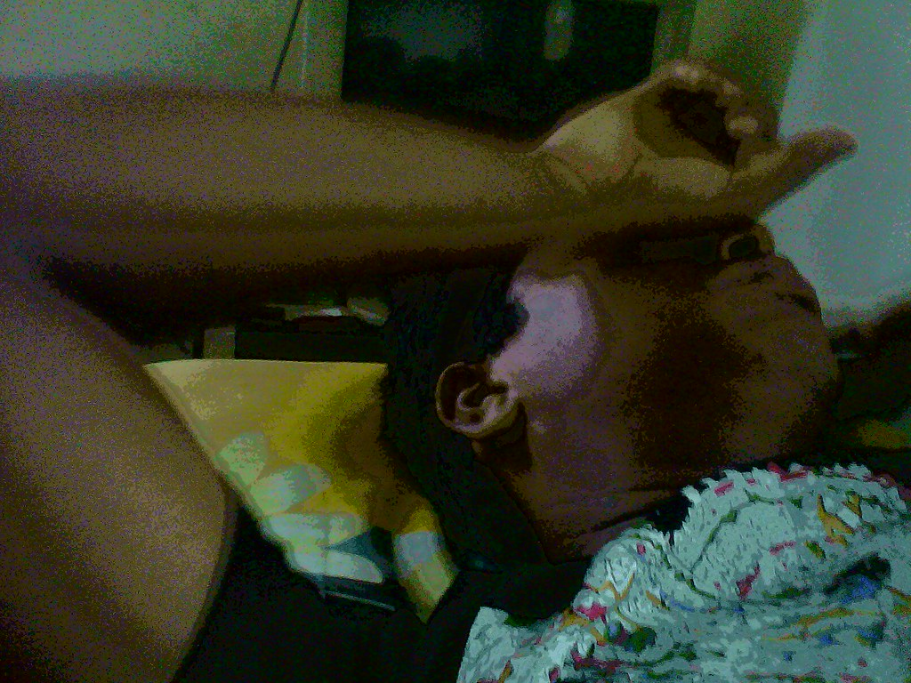
Anxiety
Notes:
Anxiety is another emotion you will likely have to cope with.
Stressful life events can initiate a bout of anxiety, and certainly the decision to leave academia can be a big life stressor.
Short term anxiety can lead to rapid, shallow breathing and a quickening heart rate. You may suffer headaches, panic attacks or a sense of doom and foreboding. You may have stomach upsets and a decrease in your libido. You might suffer from extreme fatigue. You may feel extremely irritable.
Some people find themselves ruminating, obsessively going over the same mental territory: “If only I…If he hadn’t…I should have said…” It’s like a bad movie loop. You continuously think about the situation and find yourself re-living the upsetting aspects of an experience. Or worrying about something you can’t control. With rumination, you end up reactivating the same neural network in the brain, and when you get stuck there, it’s hard to have the flexibility to generate solutions.
With all or even part of this going on, it’s pretty hard to concentrate on the future.

Slide 21

Notes:
You need to get out of the negative neural networks, and see that glass as half full.
The first thing to do is distract yourself with something you truly enjoy. Maybe it’s a crossword puzzle (that’s my poison of choice, since I really like learning new words) or a sudoku puzzle. Both of these require a degree of concentration that can help keep anxiety at bay. Talk to family or friends and let them help you remember good times, or play music that makes you feel good.
You can also try doing something that’s really different for you: bunging jumping, dancing in the rain, spending two days on a fast, going skinny-dipping, singing in a karaoke competition. The great thing about doing something really different is it can result in cross-fertilization you did not expect. You may find it has both relieved your anxiety and given you some unexpected ideas about “what next.”
Write down a list of “10 things I have done successfully.” It doesn’t matter how far back you go. Winning a spelling bee or learning to ride a bike are fine examples of success. Graduate school can certainly be on this list, too. Put it on your phone, or in your wallet on a piece of paper, but put it somewhere handy where you can look at it when you need a reminder that you have been successful before, and you will be again.
Now, create a simple action plan to create more positivity in your life. Keep it simple because life is complex! If you don’t know where to start, use the Problems/Solutions worksheet.

Slide 22

Shame
Notes:
Another issue you may have to deal with is shame.
You are not worthless, dumb, lazy, incompetent or any of the other ugly names you are calling yourself. You would never even have gotten into a graduate program if any of that were true.
Stop the negative self-talk. We all have some, and it’s meant to protect us. But it can get in the way when you are trying to move on. There is no need to keep beating yourself up, and it will not help you in the long run. Use the Self-Talk Worksheet to write down some examples of your negative self-talk. Then write down positive alternatives you can say instead. Use positive self-talk to keep from being paralyzed for action.
It is not shameful to want a life outside of academia, from time for a partner and children to earning enough to support your desired life-style, without working 80 hours a week doing teaching preps, teaching, research, administrative duties and constantly searching for the next round of funding through grant proposals. More and more folks have to fund their own salary in every field. Burning out is real.
It’s also not uncommon to hear people talk about the toxic environment of their department or school as well. Why should there be shame in leaving such a destructive atmosphere behind?

Slide 23

Notes:
Compassion
Dr. Kristin Neff, a psychology professor at the University of Texas in Austin, began her career studying shame and eventually moved to the study of self-compassion as a counterpoint to shame. She says, “Instead of just ignoring your pain with a ‘stiff upper lip’ mentality, stop to tell yourself ‘this is really difficult right now’ ” and ask “How can I comfort and care for myself in this moment?”
Here are her 3 elements of self-compassion:
Treat yourself with the kindness you would show a struggling friend.
Recognize that suffering part of the human condition—you are not alone in your experience.
Remind yourself that what you are feeling right now is not who you are.
The Mindful Self-Compassion Workbook: A Proven Way to Accept Yourself, Build Inner Strength, and Thrive Paperback – August 29, 2018
by Kristin Neff (Author), Christopher Germer (Author)

Slide 24

Notes:
Here are a few additional, simple, self-compassion exercises (and there are more on the worksheet, “Questions for coping with different emotions.”
Many people struggle with feeling inadequate. Think about the ways you have been “perfectly adequate” in your life that got you this far.
Again, ask yourself, what would a good friend say to you about your current situation?
What would you say to a friend that you know is going through a really hard time?
As you leave academia behind, you might want to create a mantra to counter the negative feelings when they threaten to overwhelm you, like “I am learning to let go;” or “It’s OK to give myself the compassion I give others.”

Slide 25
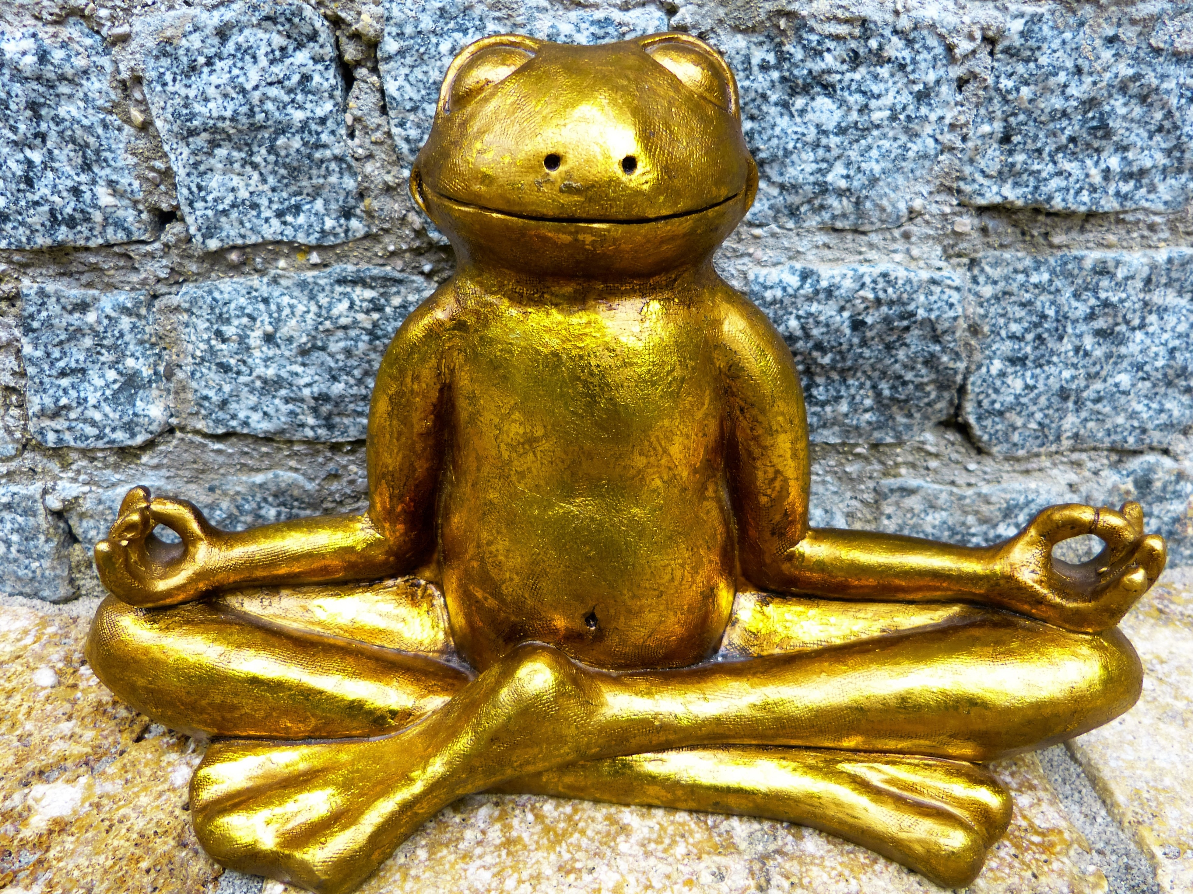
Self -care
Notes:
This is the boring, you’ve heard this all before, part. Make sure you are actually taking care of yourself. Yes, you need to do this even if you feel you are reducing the time available for ending your current research and looking for a new job. If you don’t take care of yourself, nothing else will follow.
So, the basics:
Get some physical exercise, some aerobic, some strength training.
Sleep enough hours a night to feel rested.
Get the right kind of nutrition for you.
Practice mindfulness, meditation, or other forms of spirituality. Some people even like the ritual of going to church. Do what works for you.
Find some things to do for fun. This means fun for you! Not someone else.
Keep in touch with friends and family and try not to spend to much time alone. Do not spend time with toxic people.
Keep a sense of humor: personally, I love Jorge Cham’s PhD Comics, old Gary Larsen, Calvin and Hobbs, and the occasional Non Sequiter cartoons. It can really help lighten your load.
If you need to, find a therapist or a social worker to help when you are finding this process supremely difficult.
Finally, have a plan to give an answer to anyone, even with the best of intentions, asking you about “what next?” A great answer can be, “I’m working on that right now, but I’m not ready to talk about the direction I am going yet.” Or, “When I find a job, you will be the first to know.” It’s OK to tell friends and relatives NOT to ask, too.

Slide 26

Reframing
Notes:
Reframing
“Things turn out best for people who make the best of the way things turn out,” wrote Price Pritchett, in Hard Optimism. In other words, reframe the experience.
(Price Pritchett, PhD, in Hard Optimism: Developing Deep Strengths for Managing Uncertainty, Opportunity, Adversity, and Change, 2004).
Reframing – also called “cognitive reappraisal” or “recontextualizing”– means “changing how we think about a situation in order to decrease its emotional impact.” This is a huge piece of leaving academia behind and moving on. Rather than suppressing an emotion, reframing genuinely transforms the meaning of a situation, and thus the emotional experience.
(Gross, J.J. (2001). Emotion regulation in adulthood: timing is everything. Current Directions in Psychological Science, 10, 214–219. )
In one of the more famous examples of how scientists test the effects of reframing, participants are shown a photo of a woman crying outside of a church. Typically, viewers think the woman is at a funeral and they often express sadness for her; focusing on the picture, imagining sadness, seemed to seemed to deepen their sad emotions. Participants are then asked to provide another interpretation, or to “reappraise” the scene, by imagining the woman is at a wedding and she is shedding tears of joy. This appeared to change the emotion of the viewer to one of happiness. In other words, reframing the view radically altered the experience of the picture for participants.
(“Create reframing mindsets through Framestorm” Anette Prehn, MA www.NeuroLeadership.org, NeuroLeadershipjournal, issue 4, 2012)
You can interpret any given situation in a number of different, meaningful ways. In doing so, you are creating “self-directed neuroplasticity,” a term coined by Dr. Jeffrey M. Schwartz.
(Schwartz, J. M., Gulliford, E. Z., Stier, J., and Thienemann, M. (2005). Mindful Awareness and Self-Directed Neuroplasticity: Integrating psychospiritual and biological approaches to mental health with a focus on obsessive compulsive disorder, in Mijares, S. G., and Khalsa, G. S. (Eds.), The Psychospiritual Clinician's Handbook: Alternative methods for understanding and treating mental disorders, Binghamton, NY: Haworth Reference Press, chapter 13. ISBN 0-7890-2324-5.)
What’s happening in your brain is threefold:
You are reducing emotional reactivity.
You are activiating more of your pre-frontal cortex for working memory, planning and decision-making.
You have increased your empathy for others; by changing your perspective, you have shifted away from an “it’s all about me and my problems” mindset.

Slide 27

Happiness is a sense of purpose
Notes:
Sense of purpose
A big part of moving on is creating a new sense of purpose. Whatever your purpose, it should be personally meaningful, involve giving and receiving support, and aid in developing relationships with others. Belonging to something bigger than yourself turns out to be one the single biggest predictors of happiness even into old age. Individuals in organizations compelled by an other-centered purpose feel happier, are more motivated, form better teams, and generally perform better. Purpose is beyond getting a degree or a job.
To illustrate, in April 2018, Desiree Linden became the first American woman in over 30 years to win the Boston Marathon, in some of the worst weather possible. Here’s her story from Runner’s World: Linden said in a post-race interview that early in the race she was “feeling horrible.” Until she made the decision that psychologists and neuroscientists alike say gave her the boost she needed to win: She stopped thinking about herself. Thinking she was about to drop out of the race anyway, Linden offered help to a struggling fellow runner, Shalene Flanagan. “If you need anything—block the wind, adjust the pace maybe—let me know,” Linden said. Somehow helping Flanagan helped Linden: “I got my legs back,” she said. “Helping her helped me.”
The Science Behind How Sportsmanship Helped Desiree Linden Win Boston By KIERA CARTER APR 19, 2018 https://www.runnersworld.com/training/a19862759/sportsmanship-desiree-linden-boston-marathon/
How do you figure out your own sense of purpose? One of the things I do is ask my clients to create a mission statement for themselves. This is really big picture stuff, meant to act as a guide moving forward. It’s not about “building enough cogs to ensure a profit for shareholders.” Think about what you want to do, who you want to serve and how you would like to do this. If you are having trouble getting started, begin with the First steps to setting career goals worksheet.
And while your figuring out your next best step, find something (or several things), to work on independent of being employed in academia. It could be a social/community cause; a hobby; a free software project; some sort of construction work. Whatever you choose, this kind of work will probably not end up being the ultimate purpose of your life. But it can help provide a needed psychological break from the concerns of academia, as well as some income, as you move on.

Slide 28
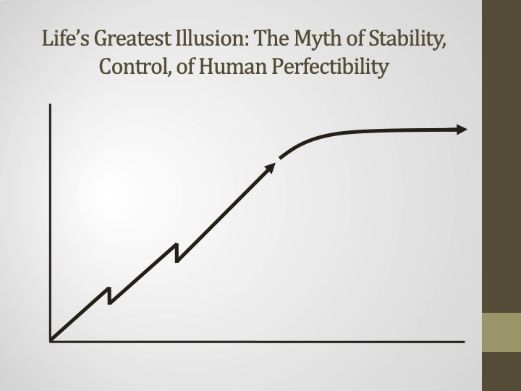
Myth
Notes:
To conclude, the academic path has created a myth that employment in academia is a linear process as well as the idea that this employment is somehow more stable than life outside of the academy. With more and more academics required to fund their own salaries, this is clearly not true.
Another and more insidious myth is that getting an academic tenure track job is within your control, if you just try hard enough. That also belies the reality of the situation.

Slide 29
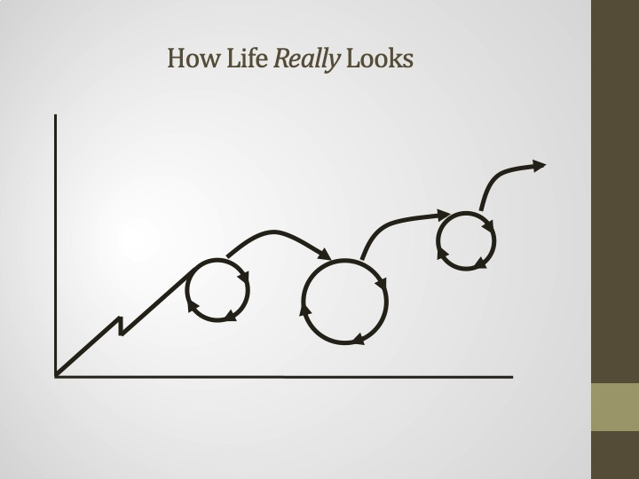
Reality
Notes:
This is what like our life really looks like. You tumble and fall, then pick yourself up again, move on, sometimes going through the many emotions we have discussed again and again.
I hope knowing that the wild swing of emotions are completely normal, and you will eventually move on, will also help you go more confidently into your new future.

Slide 30

Notes:
This may be what it feel like. It’s disorienting, scary and thrilling, all simultaneously. I hope you can enjoy the ride!

Slide 31
My contact information:
Transitioning Your Life
Website: www.TransitioningYourLife.com
Email: Hillary@transitioningyourlife.com
First author Scaling the ivory tower: Your academic job search workbook
Helping you create strategic roadmaps for a fulfilling intellectual life.
Hillary Hutchinson
The Change Strategist
Notes:
End share after 15-20 seconds; (Jen should say, stop sharing.)
The PPT available on email request, which includes references.
Questions?

